Slide 1
Red Cross and Mismanaged Blood Donations
By: Maximilien Seiersen, Matthew Edgar, Paloma Aguado, Ella Palacio, Jonathan Tran, Edmundo Briones, and Grant Gage
Notes:
Max

Slide 2

Introduction
Every 2 seconds someone in the U.S. needs some sort of blood transfusion.
13.6 million whole blood and red blood cells are collected in the U.S. in a year.
The Red Cross accounts for 40% of that.
Red blood cells must be used within 42 days (or less).
Platelets must be used within just 5 days.
But how much blood is discarded each year?
Notes:
Max

Slide 3
Solution
We created a database that stores information on blood bags, donors, hospitals, and patients which serves the following purposes:
Helps keep track of previous blood transfusions and keep a detailed history on which donors the patients received blood from and in which hospital the blood transfusions took place.
Helps hospitals keep track of when the blood was drawn, how much blood was drawn, and which hospital received the blood.
Records blood inventory for each hospital along with hospital contact information.
Notes:
Paloma

Slide 4

Solution
With the help of our database reports, hospitals can easily determine which patients need blood transfusions, which hospitals have the blood they need, how to contact the hospitals, and if necessary, how to contact the donors.
Notes:
Paloma

Slide 5
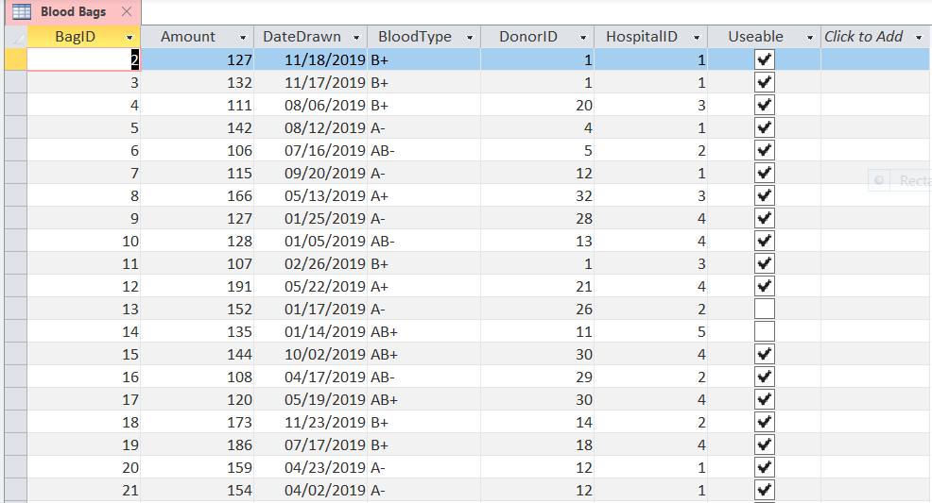
Table (Blood Bags)
Notes:
Matt

Slide 6
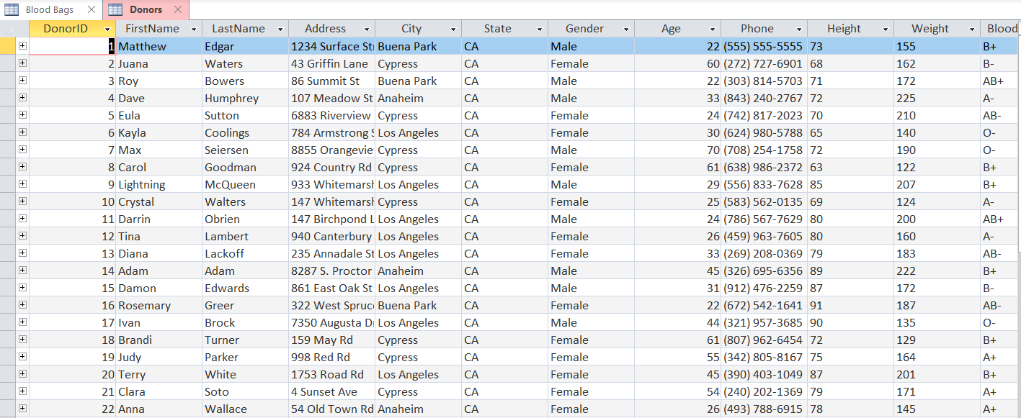
Table (Donors)
Notes:
Matt

Slide 7
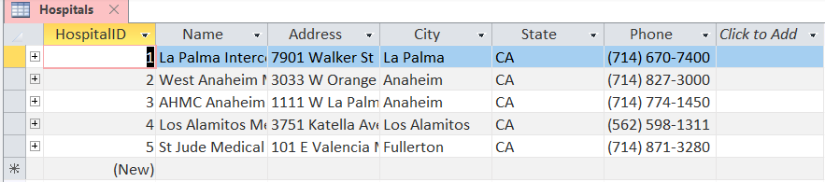




Table (Hospital)
Notes:
Matt

Slide 8
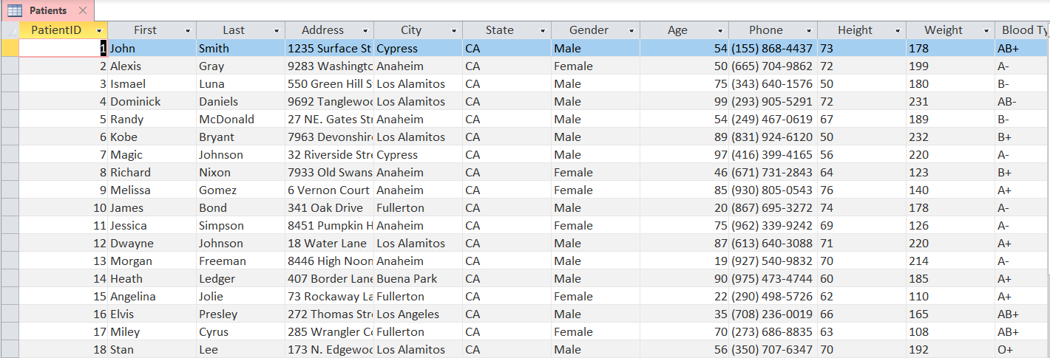

Table (Patient)
Notes:
Matt

Slide 9
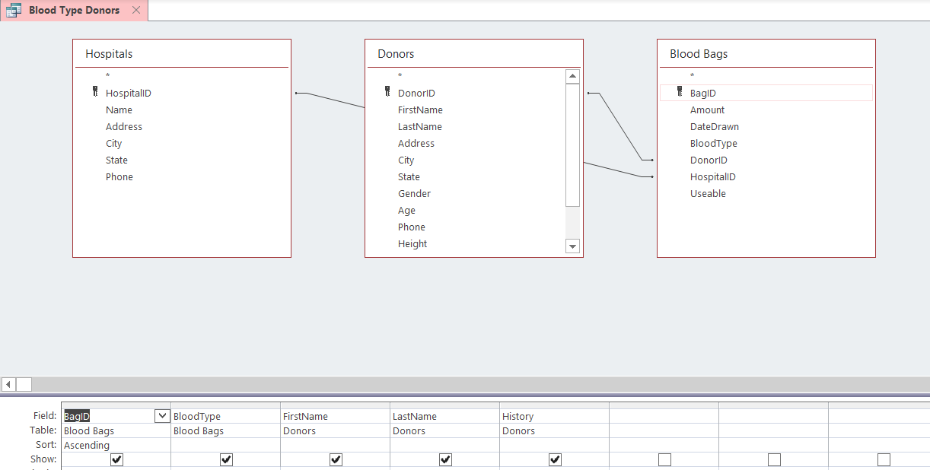
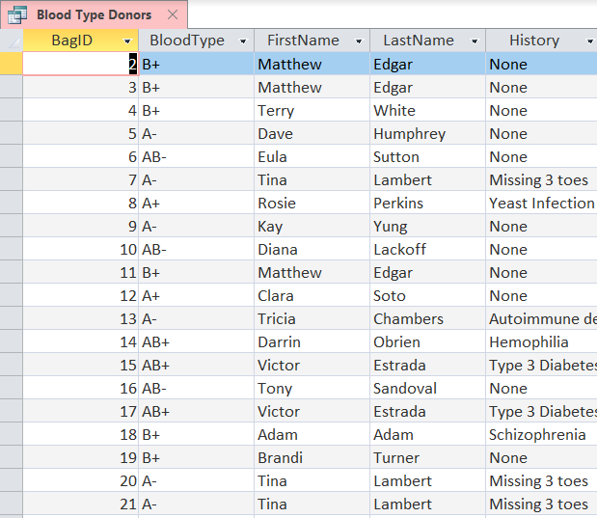
Queries (Blood Type Donors)
DesignView

Slide 10
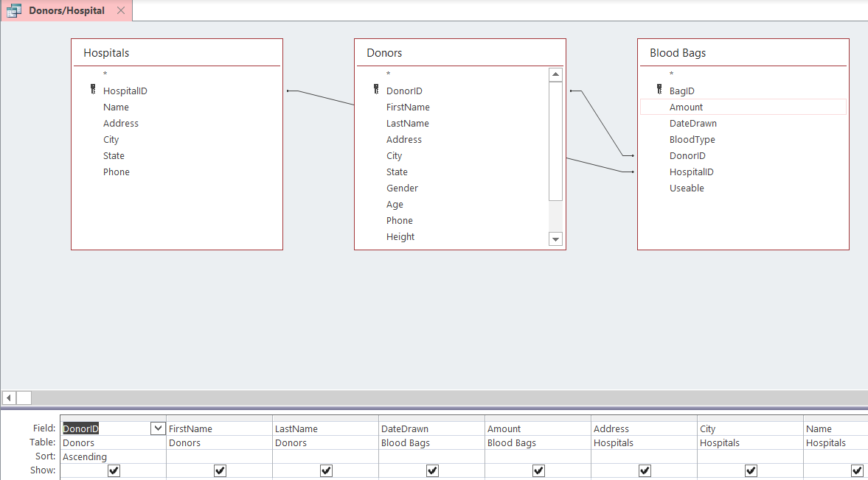
Queries (Donors/Hospital)

Slide 11
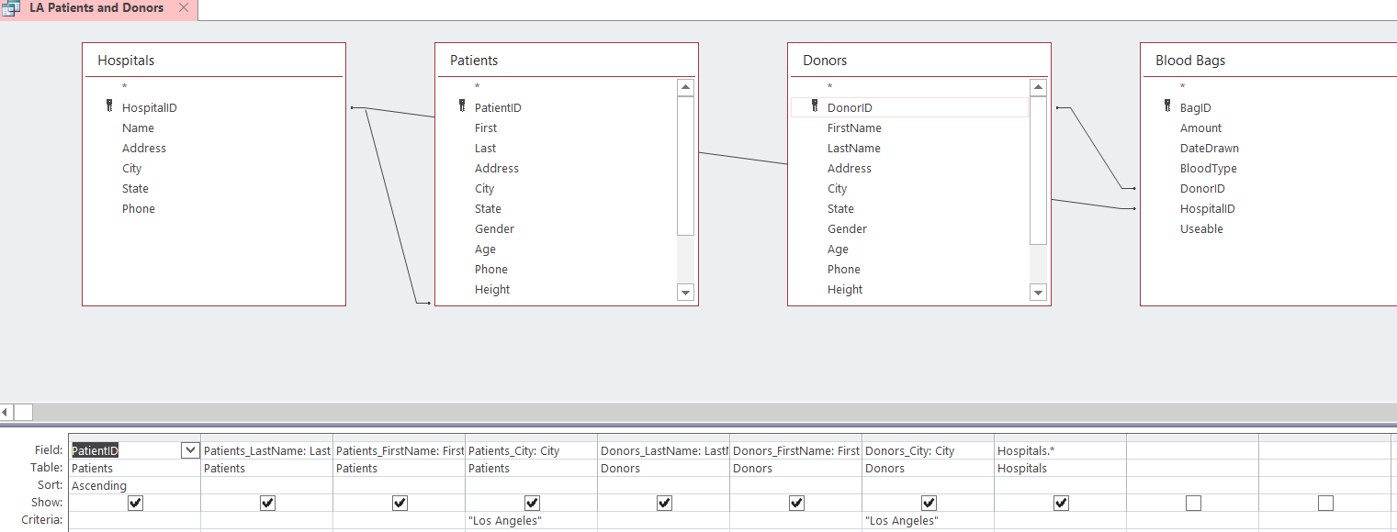
Queries (LA Patients and Donors)

Slide 12
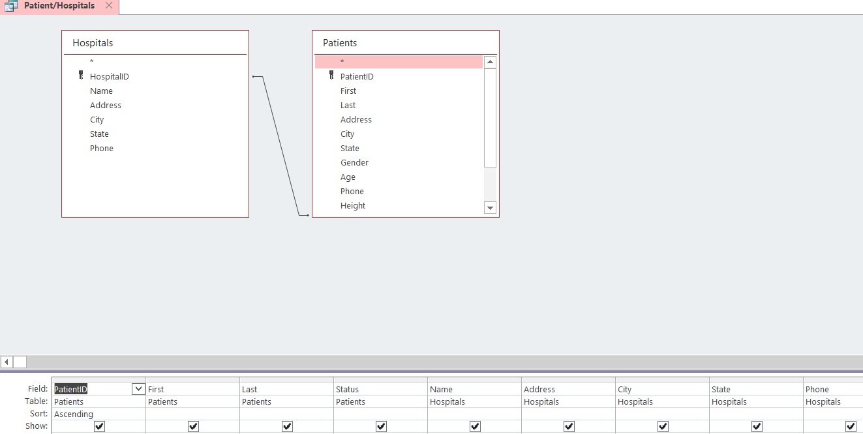
Queries (Patient/Hospitals)

Slide 13
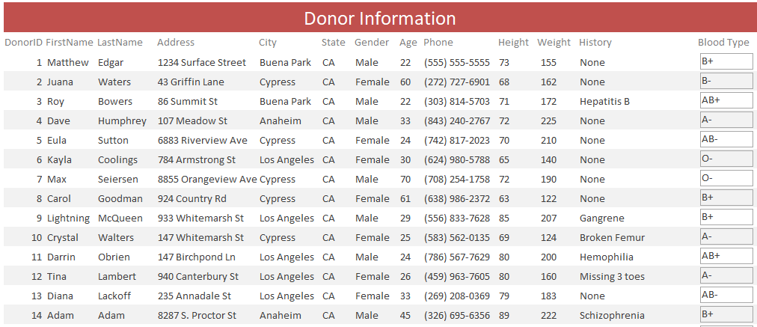
Report (Donors)

Slide 14
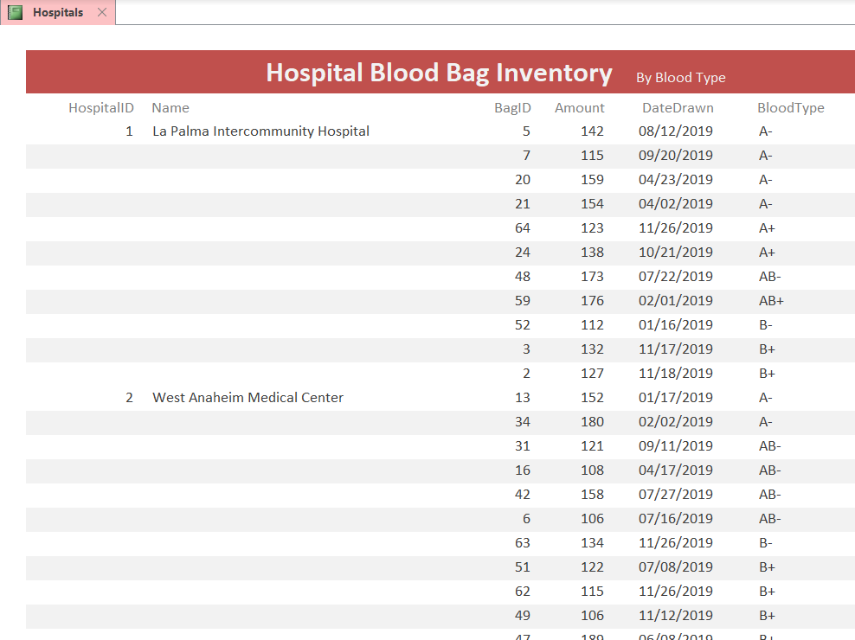
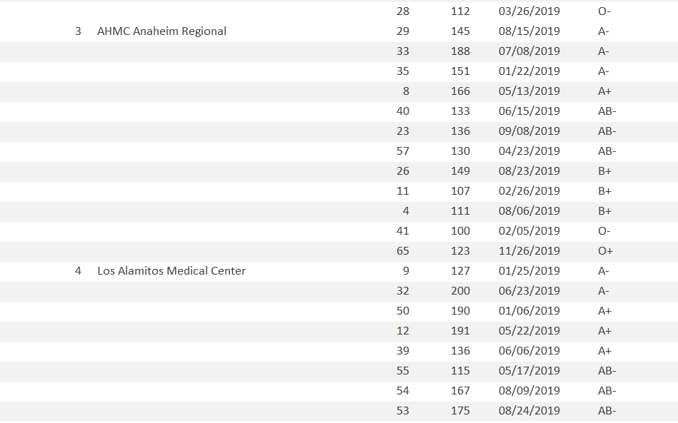
Report (Hospital Blood Bag Inventory)

Slide 15
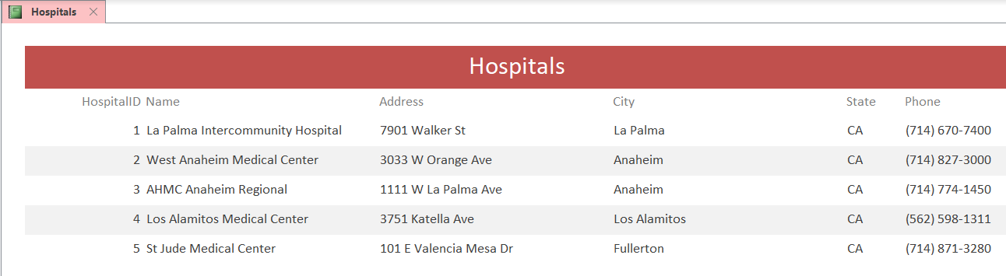
Report (Hospital)

Slide 16
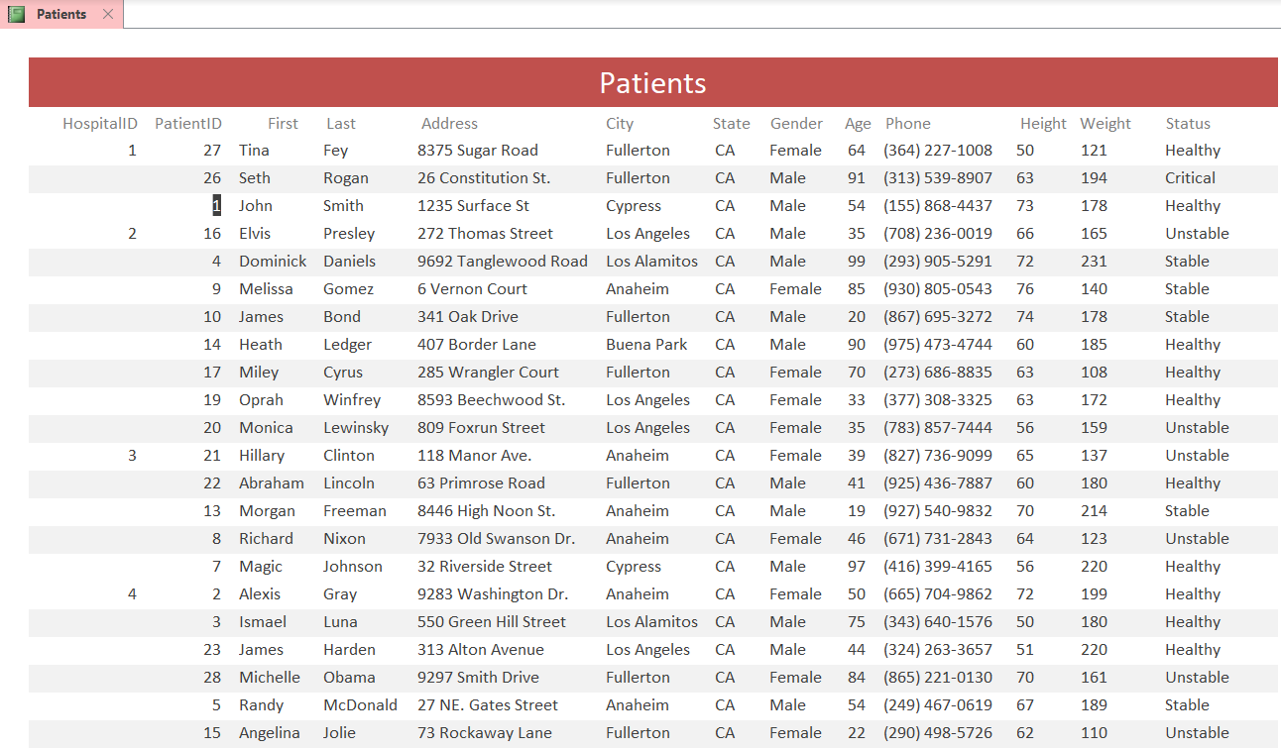
Report (Patients)

Slide 17
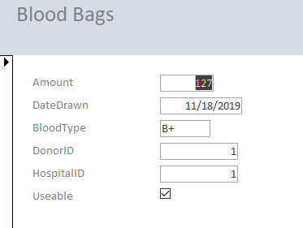
Forms (Blood Bags)

Slide 18
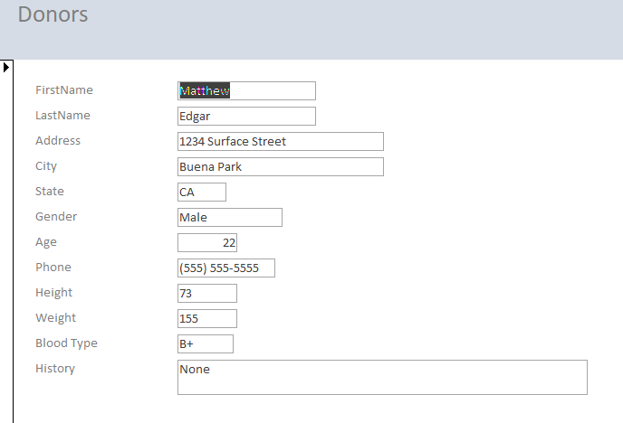
Forms (Donors)

Slide 19
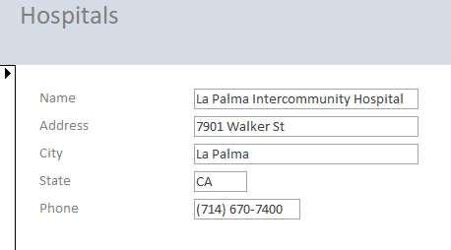
Forms (Hospitals)

Slide 20
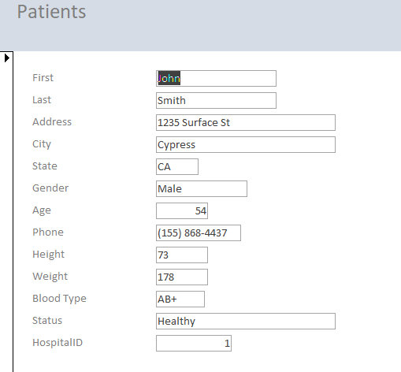
Forms (Patients)

Slide 21
Challenges
Communication
Task Delegation
Finding Data
Access Restrictions( only one person can work on the file).

